Slide 1
Music Maker
Signals & Systems
Mustafa Ali & Faizan Hussain

Slide 2
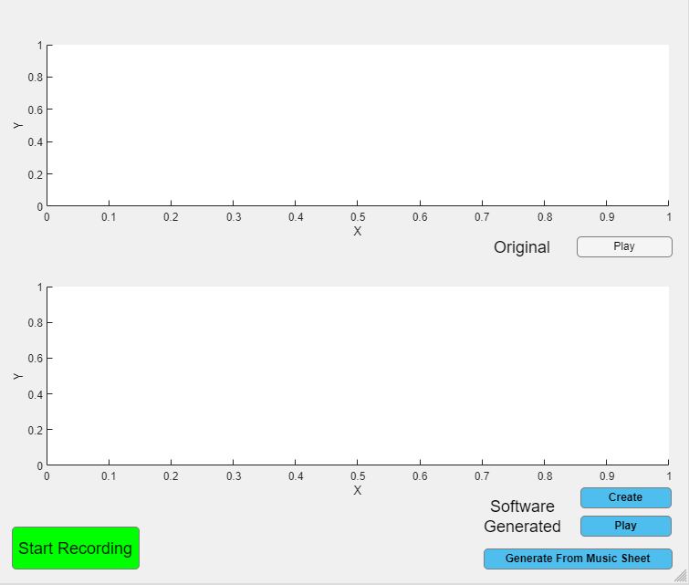
Design & Features
1. Record Unfiltered Audio
2. Create Computer generated music from recorded audio
3. Print Music Sheet of recording
4. Generate Audio from custom Music Sheet ( In Progress )

Slide 3
03
Record
Segmentation
Generation
Fourier Transfrom
01
02
04
Record the audio from the user
Smoothen & Draw an outline of the audio through convolution & then divide into sections
Apply Fourier Transform to each section & obtain the note with the highest magnitude
Fix the frequency of each note and generate audio with perfect musical frequencies

Slide 4
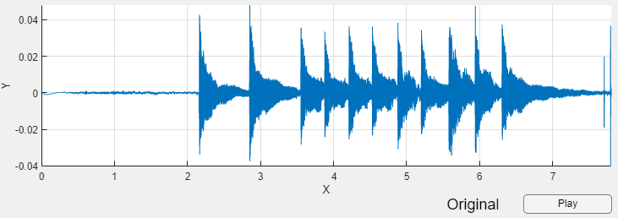
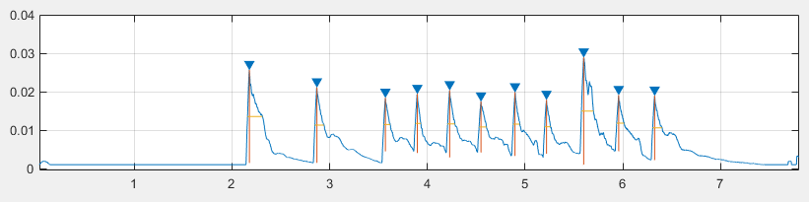
01
02

Slide 5
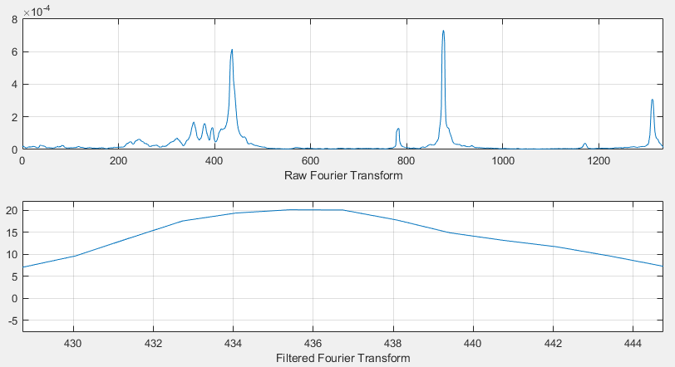
03

Slide 6
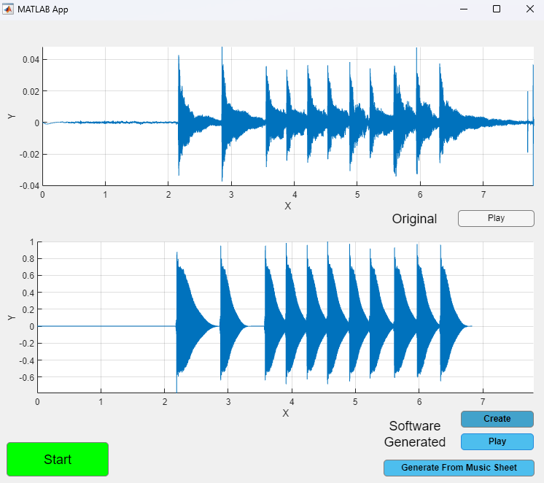
04

Slide 7
Demo
Please remain Silent

